Slide 1


Mental Health Issues in Children's
Presentation By M.JAHANZAIIB RABIA NOMAN HAMZA YOUSAF IRAM MUNIR AHMAD FAHAD

Slide 2
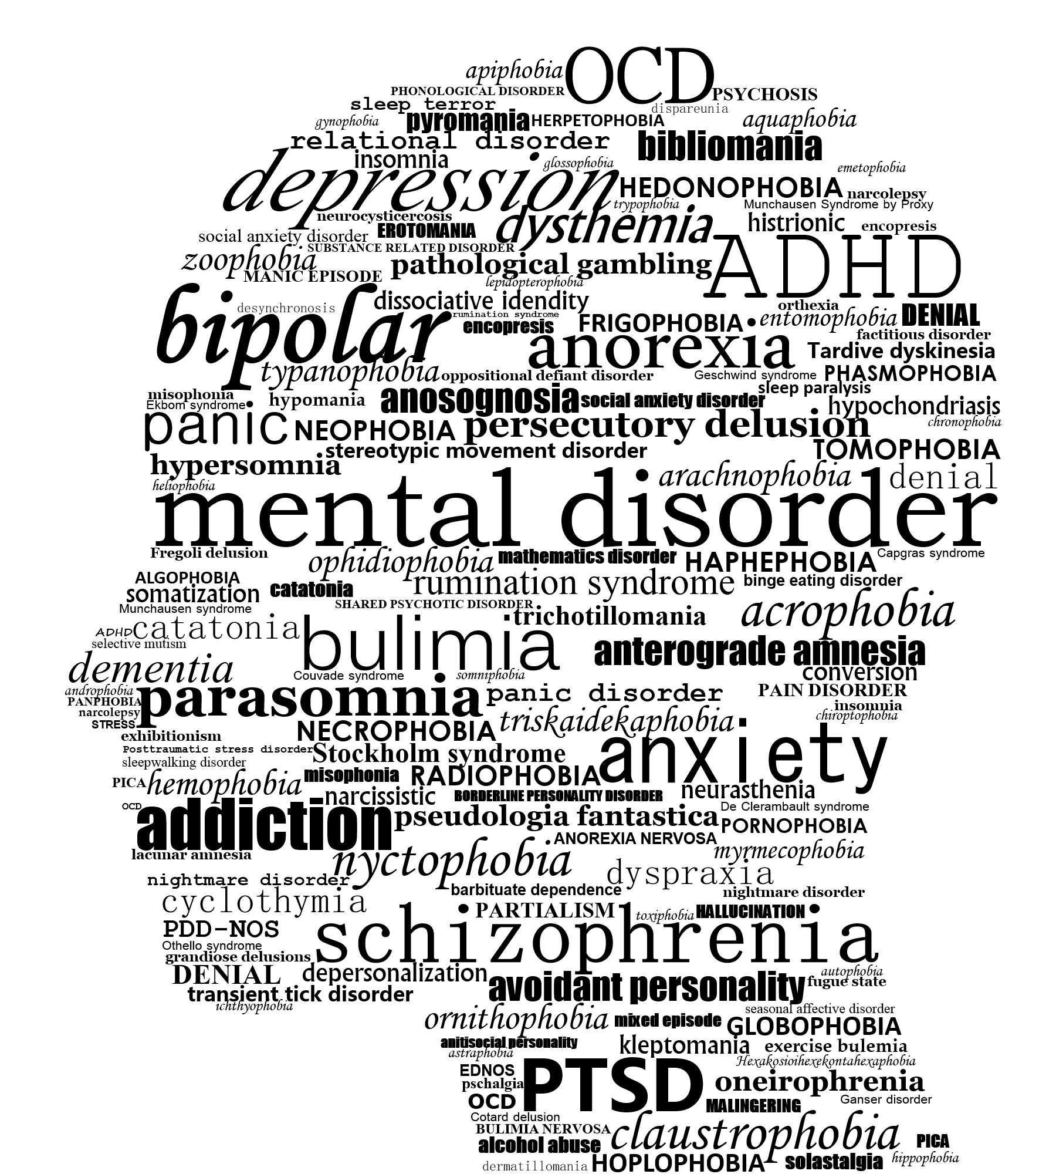
What is Mental Illness?
Mental illness can occur when brain (or a part of the brain) is not working well or working in the wrong way.
Mental illness is due to two aspects Physical damage Emotional destruction

Slide 3
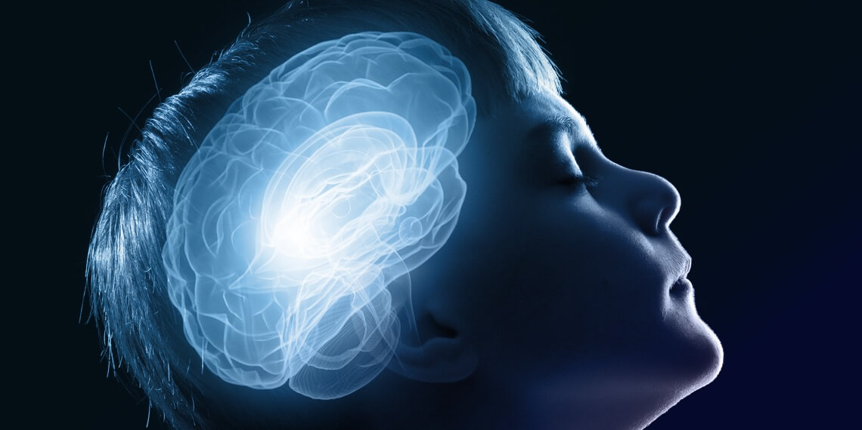
Mental health issues in children's
Mental disorders among children are described as serious changes in the way children typically learn, behave, or handle their emotions, which cause distress and problems getting through the day.

Slide 4

What are the Symptoms of Mental Illness in Children’s ?
Symptoms of mental illness
Mood Swings Hallucinations Substance Abuse Behavior Changes Difficulty Concentrating Frequent Outbursts of Anger Persistent Nightmares or Night Terrors

Slide 5

What are the Cause of Mental Illness in Children’s ?
Causes of mental illness
Biological Factors
Heredity (genetics)
Environmental Stress
Psychological Trauma

Slide 6
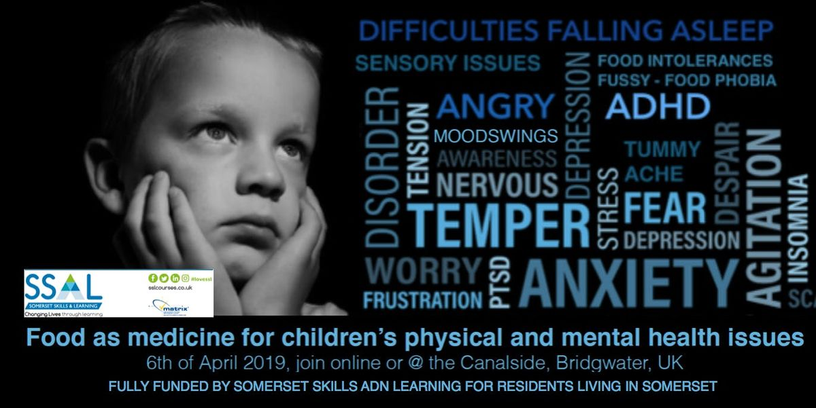
What mental health conditions affect children?
Mental Disorders in Children's Children can experience a range of mental health conditions, including:
Schizophrenia. Mood Disorders. Eating Disorders. Anxiety Disorders. Autism Spectrum Disorder (ASD). Attention-Deficit/Hyperactivity Disorder

Slide 7
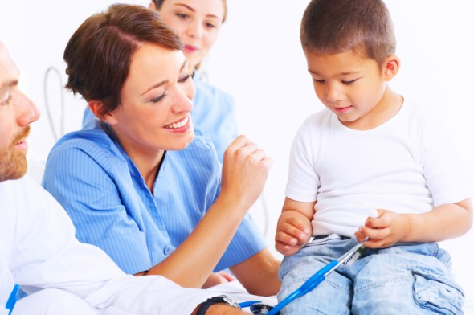
How is mental illness in children treated?
Treatment Approaches: Psychotherapy (“talk therapy”). Medications. Family counseling Support for parents

Slide 8

Myths about mental health issues in children’s
Debunking-myths about child mental health is critical to getting more children the help and understanding they deserve.
MYTH 1: A child with a psychiatric disorder Is damaged for life MYTH 2: Psychiatric problems result from personal weakness. MYTH 3: Psychiatric disorders result from bad parenting.

Slide 9

Myths about mental health issues in children’s
MYTH 4: Children grow out of mental health problems. MYTH 5: Children are overmedicated. MYTH 6: Therapy for kids is a waste of time. MYTH 7: A child can manage a psychiatric disorder through willpower.

Slide 10
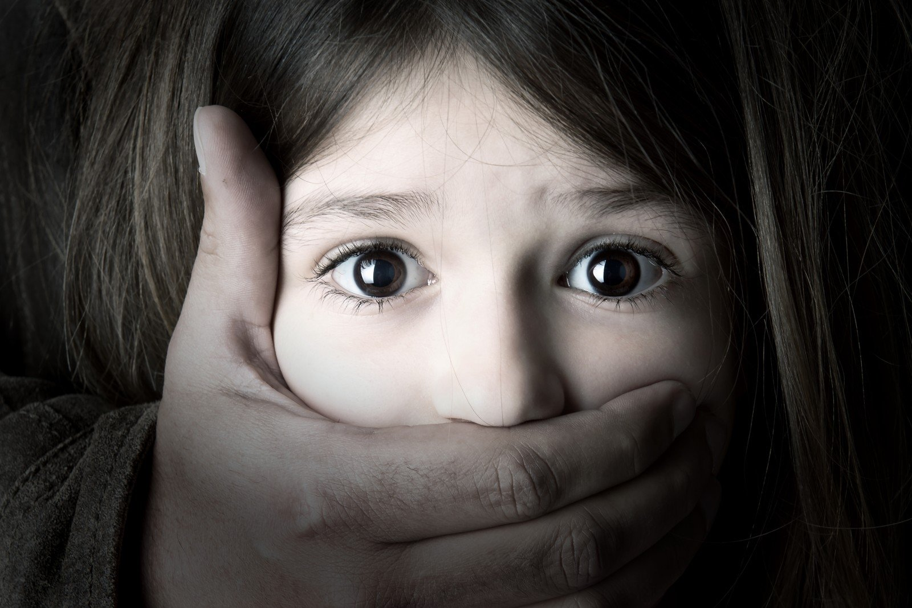

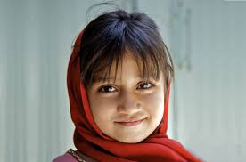
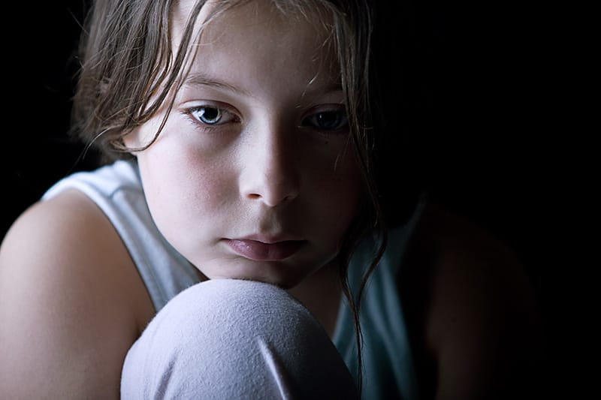
NEVER GIVE UP SOMEONE WITH MENTAL ILLNESS
WHEN “I” IS REPLACED BY “WE” ILLNESS BECOMES WELLNESS.

Slide 11
Thank You...

